Slide 1
Predicting NBA Score Lines using ML Models
Colin Johnson, Milind Rajavasireddy, Michael Singer, and Darren Sohn

Slide 2
TABLE OF CONTENTS
01
02
03
04
OBJECTIVE
Predict NBA final game scores
MODELS
Linear Regression, Bayes Ridge Regression, Random Forest
RESULTS
Simple models vs complex models
APPLICATIONS
Predicting previous NBA game

Slide 3
Objective
01

Slide 4
Objective
Our objective with this presentation and project was to present some machine learning models that can predict game scores and ultimately a winner of a game.

Slide 5
Models
02

Slide 6
Linear Regression
Bayes Ridge Regression
Random Forest
Simple, interpretable but sensitive to outliers and assumes linear relationship
Robust, regularized regression coefficients but computationally intensive
Interpretable, robust but prone to overfitting

Slide 7
Feature Selection
Our models take into account 5 statistics for each team: Field goal %, free throw %, 3-point %, # of assists, and # of rebounds
Also takes into account whether the team of interest is playing at home or away
Total # of features = 11
Model Complexity Experiment
Our regression models yielded very small coefficients corresponding to assists and rebounds
Attempted to reduce model complexity by omitting each of these features independently, as well as together
The resulting errors were marginally greater than those of models including all features, so we decided to keep them
Linear regression coefficients:
coefficients: [ 1.64185449e+02 1.99955878e+01 3.26257200e+01 3.82021949e-01
8.31116845e-01 7.52954602e+01 4.92838120e+00 1.63804019e+00
-1.33345909e-02 4.02475363e-01 3.15774504e-01]
Notes:
Our models take into account 5 statistics for each team when predicting the score of a given team (team of interest and opposition): Field goal %, free throw %, 3-point %, # of assists, and # of rebounds
Also takes into account whether the team of interest is playing at home or away (a boolean value)
Total # of features = 11 (5 for team of interest, 5 for opposition, home/away)
Model Complexity Experiment - we looked into reducing model complexity
Our regression models yielded very small coefficients corresponding to assists and rebounds
Attempted to reduce model complexity by omitting each of these features independently, as well as together.
The resulting errors were marginally greater than those of models including all features, so we decided to keep them
Linear regression coefficients:

Slide 8
Results
03

Slide 9
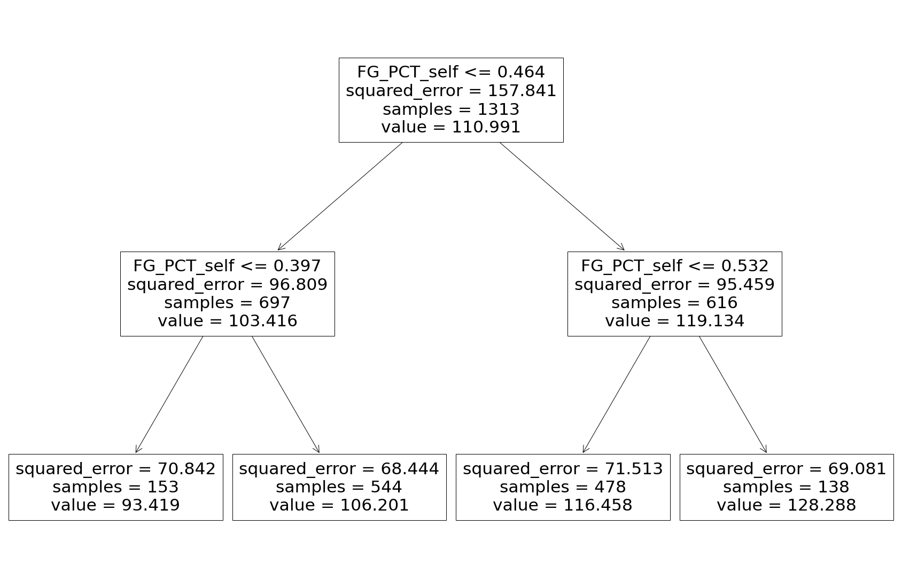
Random Forest Visualization
Decision tree models are helpful in their interpretability
At each node, the model chooses a predictor that best splits the data into two subsets
This subsetting happens for a set amount of times (hyperparameters) and repeated multiple times (n_trees)
The final “random forest” would be the averages of all trees
Notes:
N_trees = 20
Max_depth = 2 (only two layers)

Slide 10
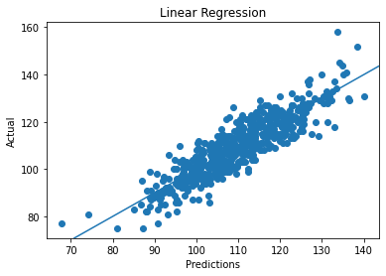
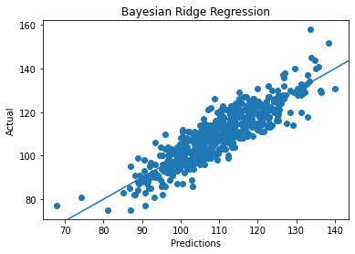
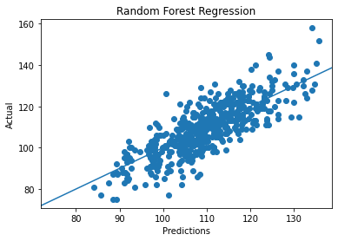
Model Visualization, Accuracy, and Error
Linear Regression
Bayes Ridge Regression
Random Forest
Accuracy: 0.78345 MSE: 34.28193
Accuracy: 0.78339
MSE: 34.29066
Accuracy: 0.64490
MSE: 56.34691
Notes:
Here is the model visualization for all three models that we ended up using
As we can see, all three models like pretty similar in terms of shape and prediction
However the linear regression and bayes ridge regression seem better fit at predicting scores
A lot more tightly clustered near the line of best fit for linear and bayes ridge regression whereas random forest is a lot more dispersed and farther
They are similar since their logic and math are similar
Random Forest is more dispersed and can be a result of overfitting

Slide 11
Applications
04

Slide 12
Why is this useful?
To recap, our model predicts points scored given end of game stats
If we already have end of game stats, why would we need to estimate points scored?
Can use season averages to predict how many points a team will score before a game happens!

Slide 13
Demo!

Slide 14
Predictions for Jazz vs. Suns on 2022-04-08
Using end of game stats:
Linear Regression:
Predict Jazz to score 99
Predict Suns to score 114
Bayesian Regression:
Predict Jazz to score 99
Predict Suns to score 114
Random Forest Regression:
Predict Jazz to score 96
Predict Suns to score 116
Using average stats for the season:
Linear Regression:
Predict Jazz to score 97
Predict Suns to score 100
Bayesian Regression:
Predict Jazz to score 97
Predict Suns to score 101
Random Forest Regression:
Predict Jazz to score 117
Predict Suns to score 117
Actual points scored for Jazz: 105
Actual points scored for Suns: 111

Slide 15
Running Predictions on 2021-2022 Season
Correctly predicting winner from end of game stats:
0.8549382716049383
Correctly predicting winner from team season average stats:
0.6118827160493827

Slide 16
Areas for Further Research/Improvement
Feature selection
Live Predictions
For example, adding EMA’s (exponential moving averages) of a team’s win rate could serve as useful indicators of a team’s form. Steals, turnovers, etc.
This could facilitate more accurate predictions when not considering shooting percentages.
Using mid-game data (halftime or quarterly), we could give live predictions on the outcome of a game
More complex predictions
Using results to assign distributions around target so we can predict probability of a winner

Slide 17
References
https://www.kaggle.com/datasets/nathanlauga/nba-games?select=games.csv
https://www.nba.com/stats/teams/traditional
https://medium.com/@curryrowan/the-complete-guide-to-random-forests-part-1-427c9cba8336

Slide 18
Thank You!

